Slide 1
Learning about Taxes with Intuit ProFile

Slide 2
Chapter 5
Advanced T1 Work

Slide 3
In this Chapter
T1 and dependants
Optimization
A T1 for the self-employed

Slide 4
Advanced T1s
Notes:
Refer to Page 6 and explain that ProFile can accommodate anything from the most basic T1 to the most advanced.
Let’s take a look…

Slide 5
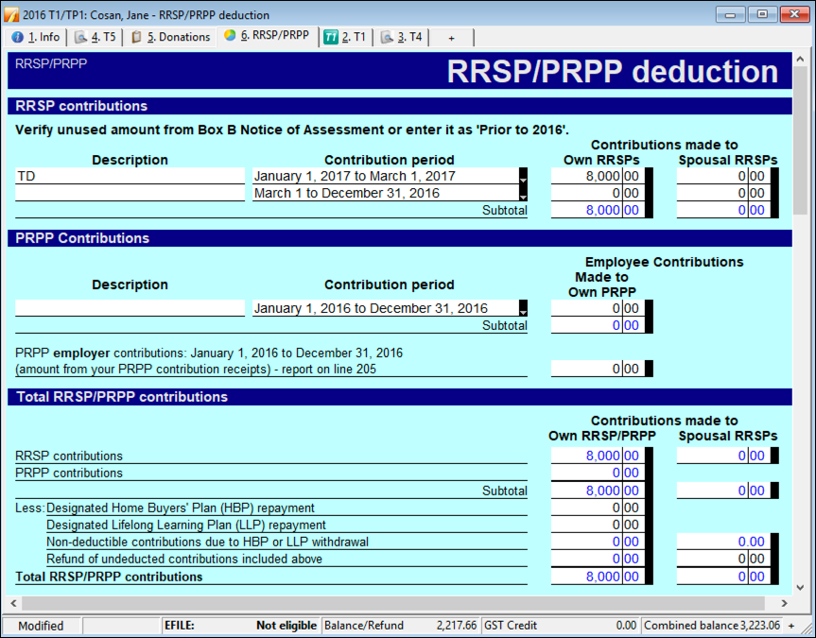
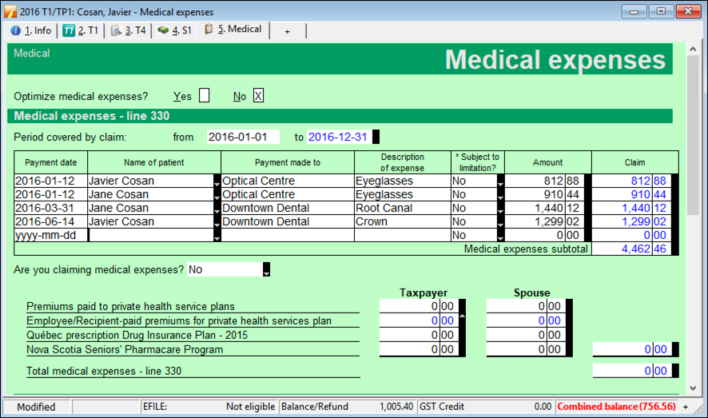
rrsp
medical expenses
Pages 6-8
advanced t1
Notes:
Refer to pages 6-8 and discuss
- Recording RRSP slips and medical expenses

Slide 6
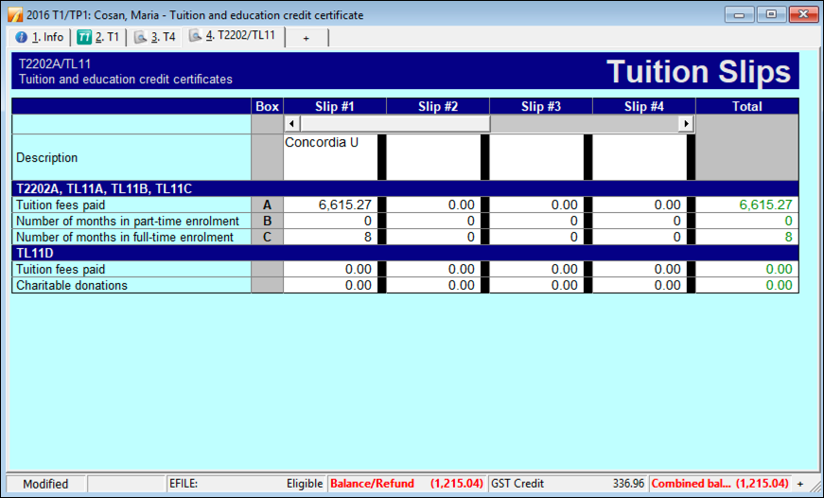
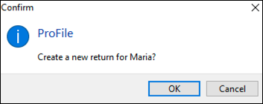
family linking
dependants
tuition
Pages 9-11
advanced t1
Notes:
Discuss
Family Linking – p 9 t
Creating a dependant’s return – page 10
Tuition transfers - Page 11

Slide 7
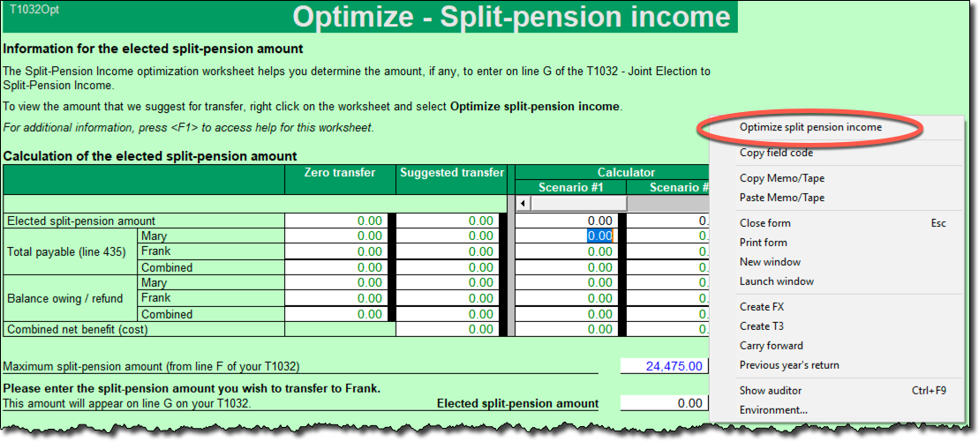
optimizing
pension splitting
Pages 11-13
advanced t1
Notes:
Refer to Pages 11-13 and discuss
Introduce Optimizing – P11
Demo pension splitting – P12-13

Slide 8
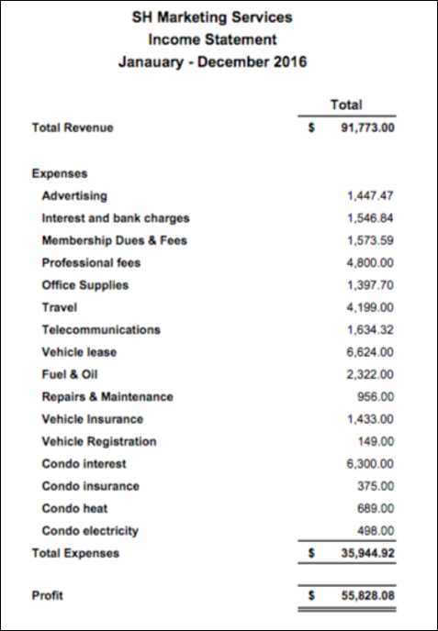
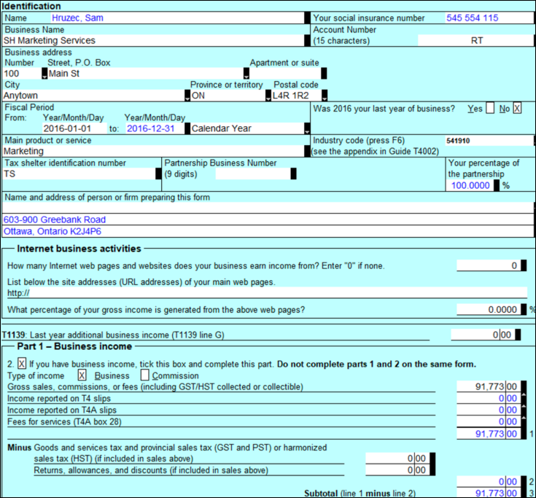
P&L - T2125
vehicle
home office
pages 13-16
the self-employed
Notes:
Refer to page 13 and introduce a T2125 for the self-employed
Describe the P&L at page 14 and the T2125 at Page 15
Go on to Page 16 and discuss the way in which vehicle expenses are entered
And also discuss home-office expenses

Slide 9
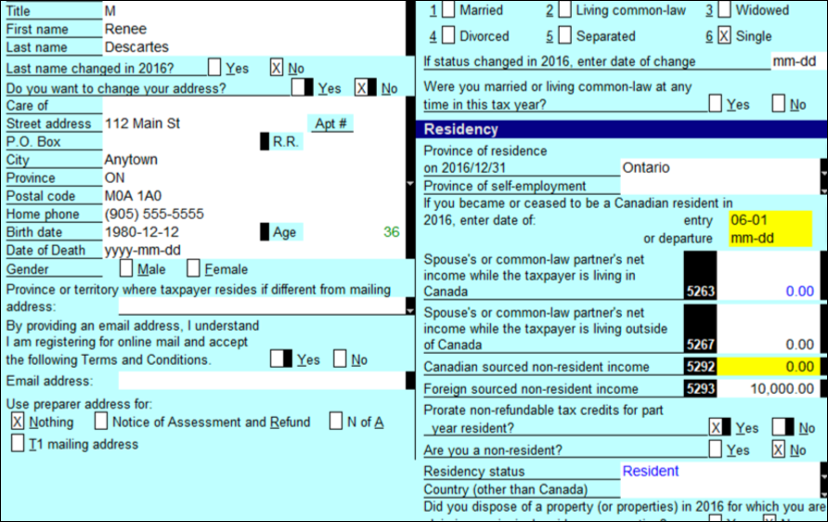
Part-year residents
date of entry
Cdn non-res income
Foreign non-res income
Pages 17-18
part-year residents
Notes:
Discuss Part-year residents – at pages 17-18

