Slide 1
Learning about Taxes with Intuit ProFile

Slide 2
Chapter 6
An Online World

Slide 3
In this Chapter
Auto-fill My Return
ReFile
Hub & Link

Slide 4
an online world
Notes:
Refer to Page 6 and discuss how everything’s going online
Every day, more and more businesses are taking things online. Online stores; online information; online payments; online communication—all are part of our everyday lives. It should come as no surprise, then, that tax preparers too are increasingly using cloud tools. Canada Revenue Agency, for example, demands that tax preparers EFILE tax returns and, at the same time, with a dedicated Represent a Client account, CRA gives tax preparers online access to an array of client information that was unthinkable just a few short years ago. ProFile is accentuating this cloud trend as well. As a ProFile user, you have access to an increasing number of cloud tools.

Slide 5

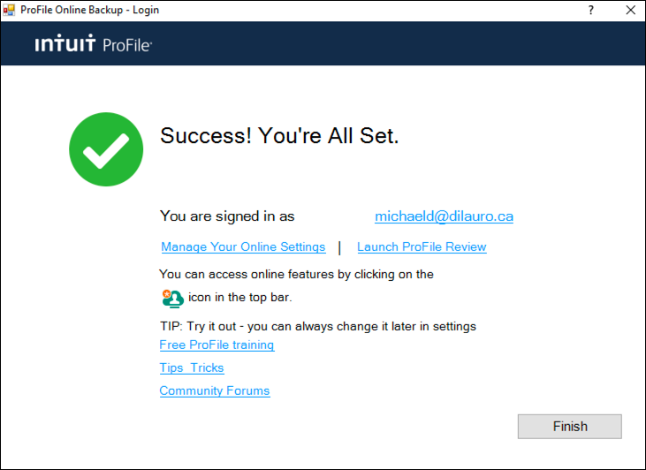
accessing
live chat
notification centre
online setting
online toolbar
Pages 6-10
an online world
Notes:
Refer to pages 6-10 and describe the icons on the online toolbar
Point out how to create and/or access your online account - Pp 9-10

Slide 6
autofill my return
Notes:
Refer to page 10 and introduce CRA’s AFR
AutoFill My Return (AFR) is a secure Canada Revenue Agency (CRA) service that allows individuals and authorized representatives to automatically fill-in parts of a T1 return with information that the CRA has available at the time of filing the return. Many authorized representatives are already accessing CRA’s online services to gather client information. AFR is the logical next step. By filling in key tax data, CRA’s AFR simplifies the tax preparation process

Slide 7
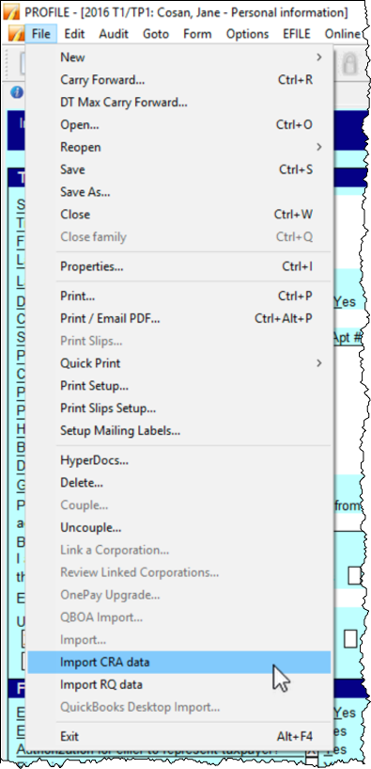
What is it?
Signed T1013
What's required?
Auto-populate tax fields from CRA site
Rep a client access
Pages 10-12
autofill my return
Notes:
Refer to pages 10-11 and mention what AFR does and how you use it
Mention the requirements
Must be an authorized representative (Represent a Client ID and password)
T1013
Refer to Page 12 that describes how to launch AFR
Go to File > Import CRA Data
Click > Launch CRA Website

Slide 8
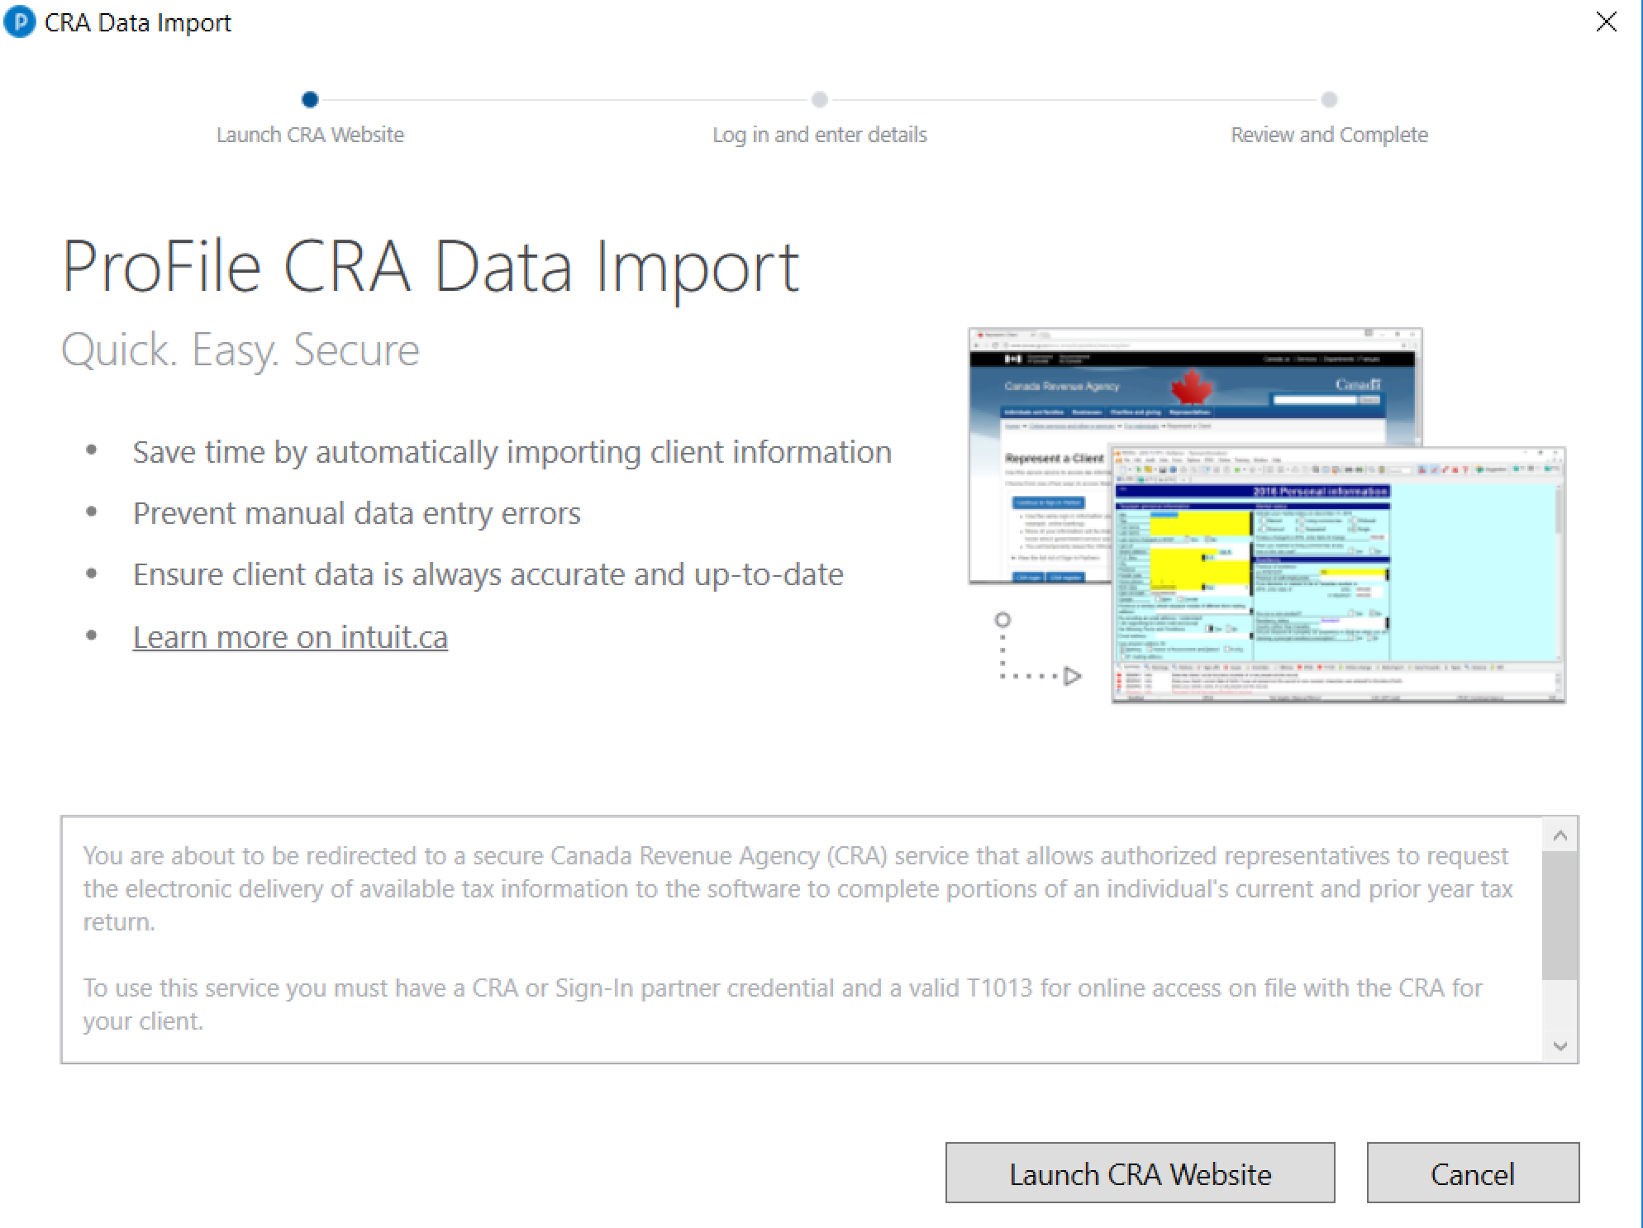
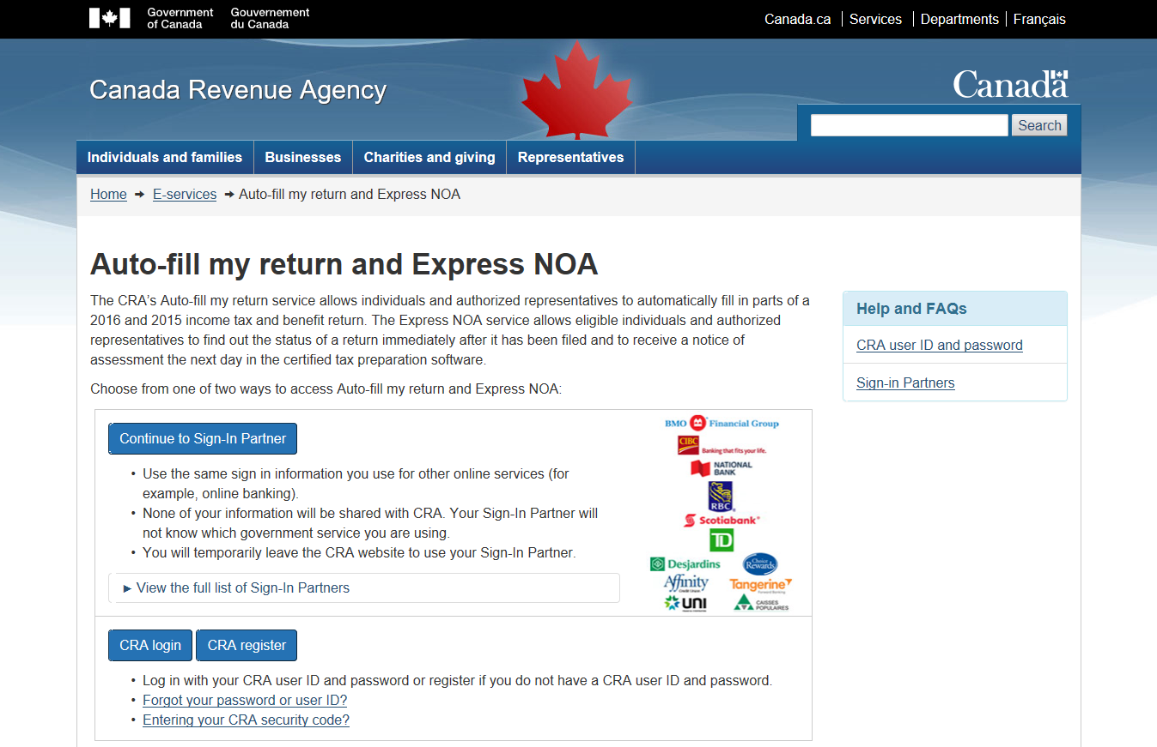
Pages 12-13
autofill my return
Notes:
Mention that these images are duplicated at Pages 12-13

Slide 9
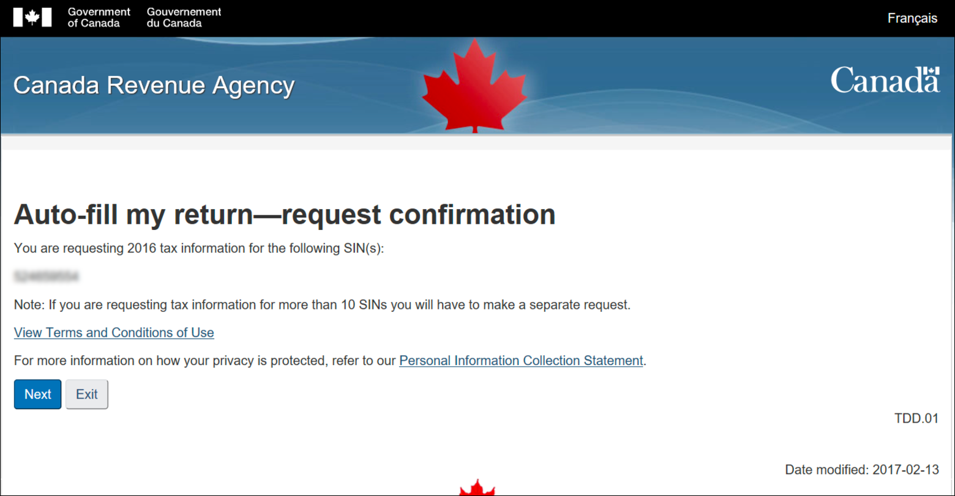
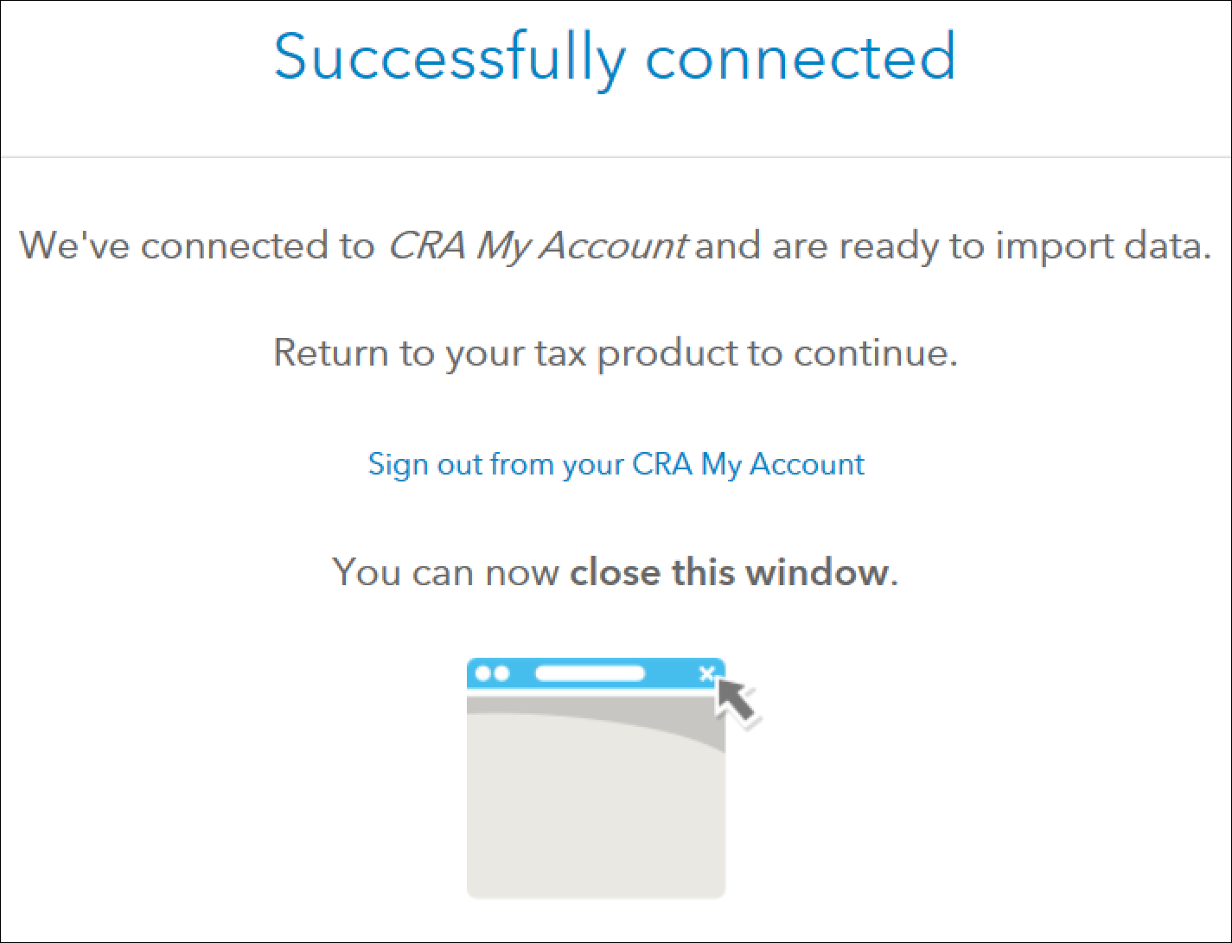

autofill my return
Notes:
Mention that these images are duplicated at Pages 12-13

Slide 10
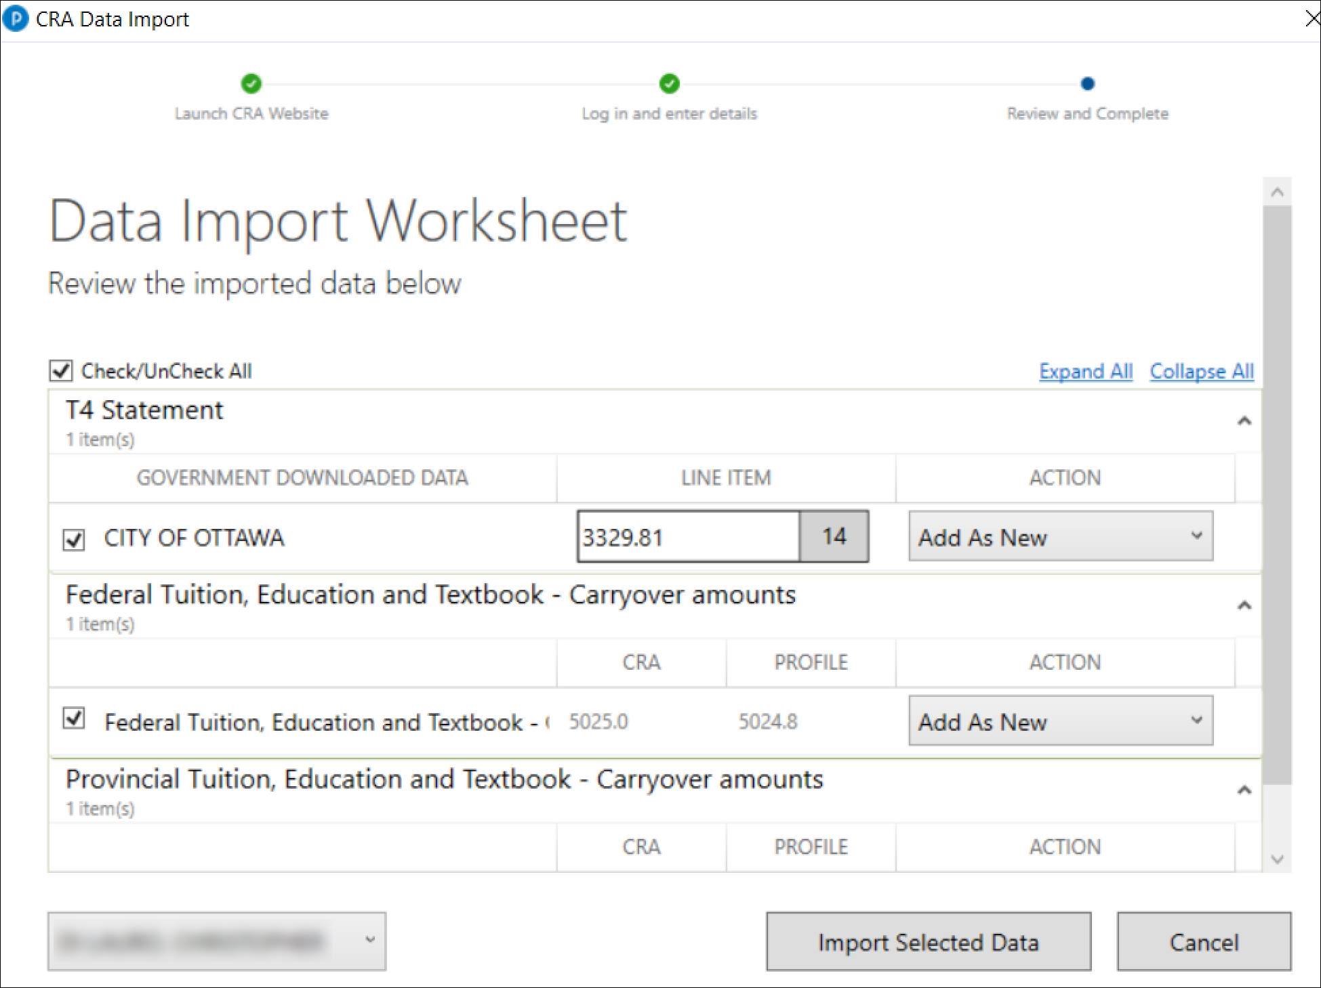
autofill my return
Notes:
Mention that these images are duplicated starting on Page 14

Slide 11
ReFile
Page 14
Notes:
Introduce ReFile at page 14

Slide 12
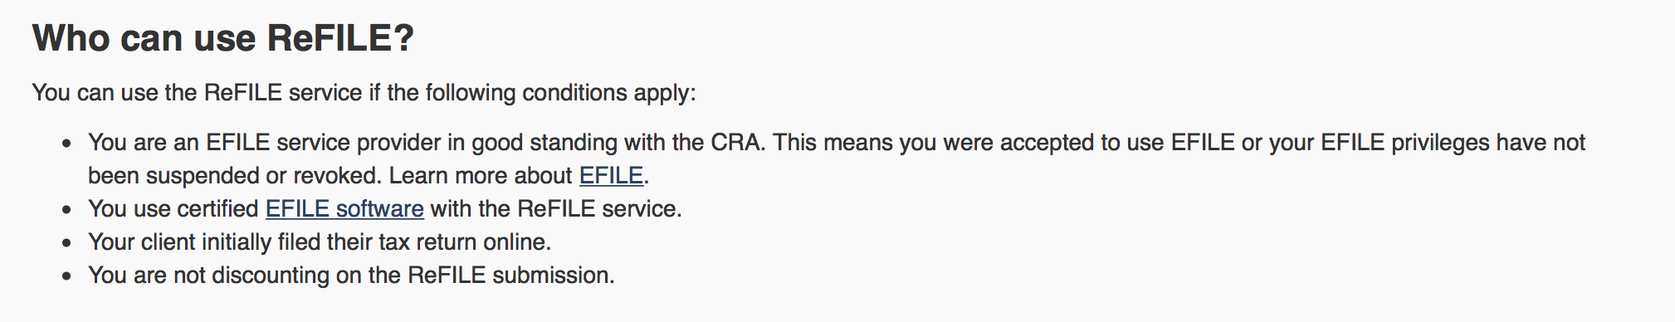
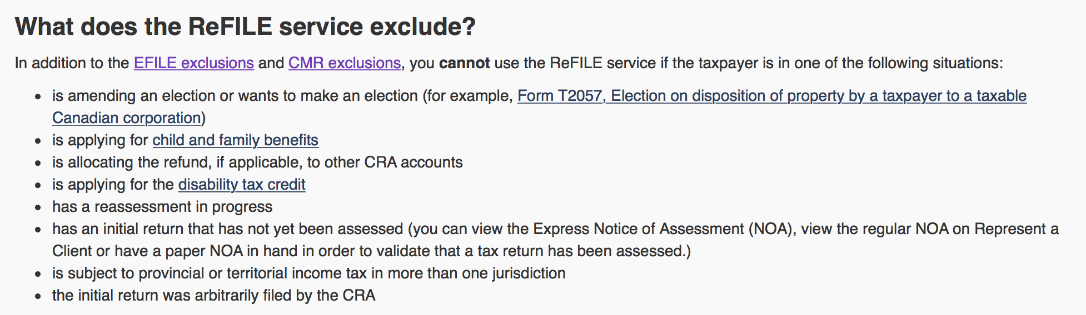
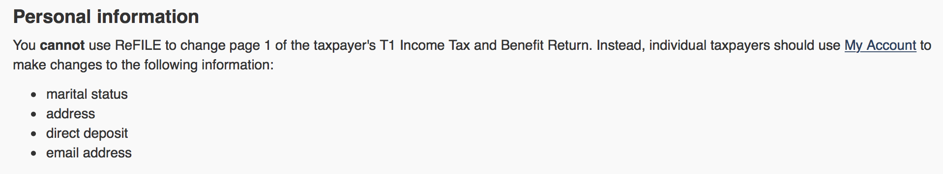
T1 ReFile
What’s excluded?
Limitations
Who can use?
2015 & 16
Page 14
ReFile
Notes:
Mention that the image on left is discussed at Pp 14
MENTION 2015 AND 2016 ONLY
Discuss the scope, limitations and exclusions, and demo how to ReFile a T1
PER CRA’S WEBSITE
The online system accepts only nine adjustments per tax year for each taxpayer, whether the taxpayer or you or the CRA initiates the adjustments. If you go over the limit, you will get an automated response saying the limit has been reached and explaining how to send a paper request. Make additional requests on paper, preferably using Form T1-ADJ, T1 Adjustment Request, and mail them to the CRA.

Slide 13
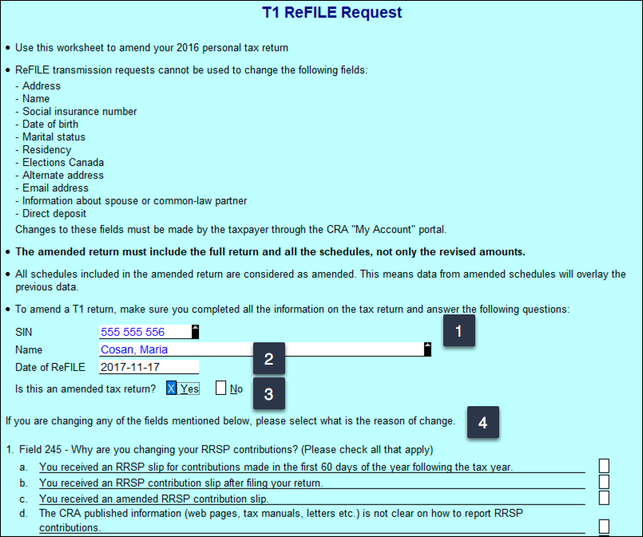
How to
Open T1 > Save as
Amend T1
F4 > T1Refile
Signed T183
Want to Refile like you EFILE?
Info Page > ReFile confirmation
Page 15
ReFile
Notes:
Detailed steps start at Pg 15 and go on to page 18
Open existing return and Save As
Make changes to tax file as required
Open ReFile Form (F4 > T1Refile)
Ensure SIN is indicated
Enter current date in date field
Check the Box to indicate Amended Return
Go through form questions at bottom of Page
Open T183 (Page 34)
Notice the R net to the tax year at top right
Check the “Want to REFILE like you EFILE) Box
OBTAIN SIGNATURE ON THE NEW T183 (Page 35-36)
Go to INFO Page and Point to REFILE cofirmation

Slide 14
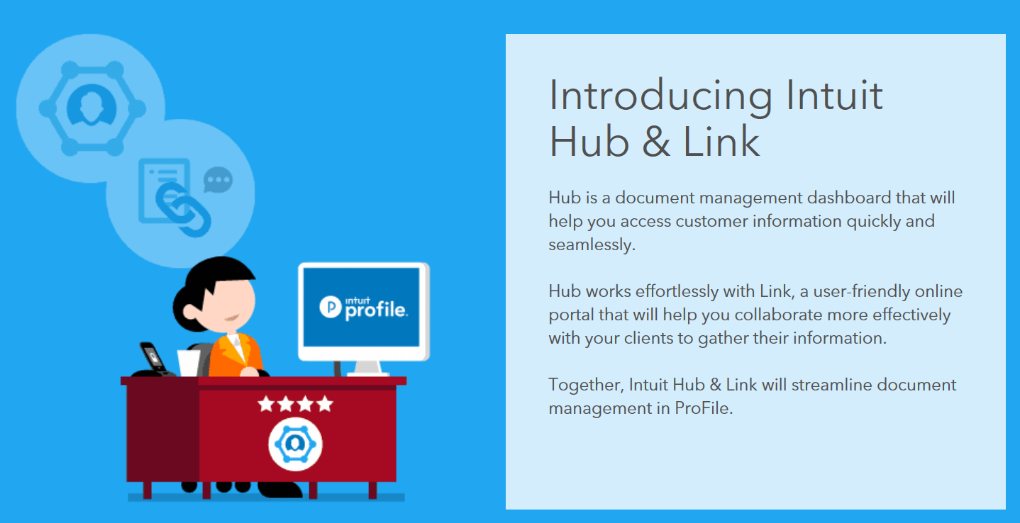
Hub & Link
Page 18
Notes:
Refer to Page 18 and discuss client communication
Gathering and disseminating client information used to be straightforward. When paper was the only option, clients would stop by the tax preparer’s office to drop off their documents, and come back later to pick up their completed tax returns.
Now, thanks to online tools, clients rarely visit their tax preparer’s office, oftentimes preferring to email their documents. Email, though, comes with two inherent risks—privacy and efficiency. The fact is that regular email is a bad idea for sending private and sensitive data. In addition, controlling the influx of emailed attachments, especially during a very busy tax season, can lead to lost or misplaced documents, and erroneous or incomplete tax returns.
What tax preparers need, then, is a safe and efficient method for sending information to and requesting documents from their clients. And now, with Hub and Link, ProFile has that very thing built in.

Slide 15
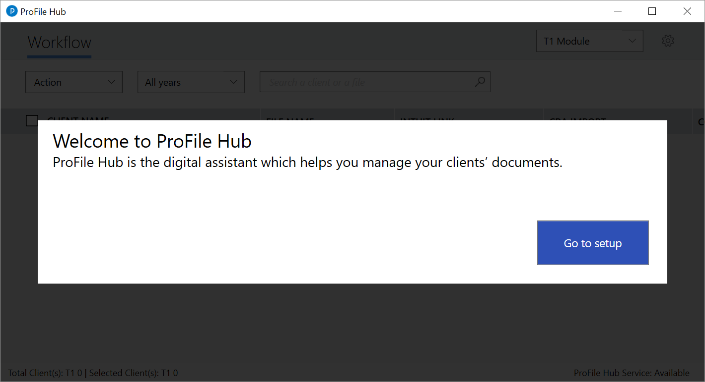
Page 19
Hub
Notes:
Detailed steps start at Page 19
From ProFile’s menu, select Go To Hub
When this window opens, choose Go To Setup

Slide 16
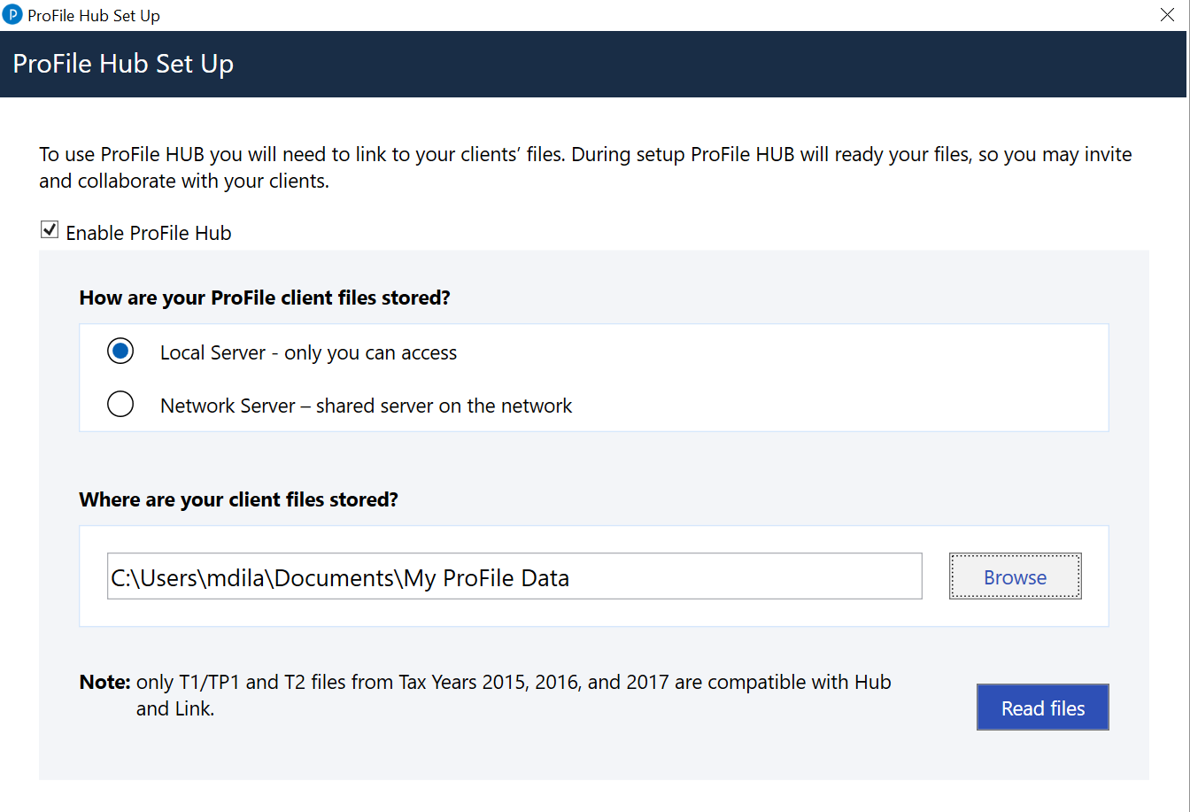
Page 19
Hub
Notes:
Click the checkbox
Select local or network server
Browse to your data files (usually My ProFile Data)
Click “Read Files”

Slide 17
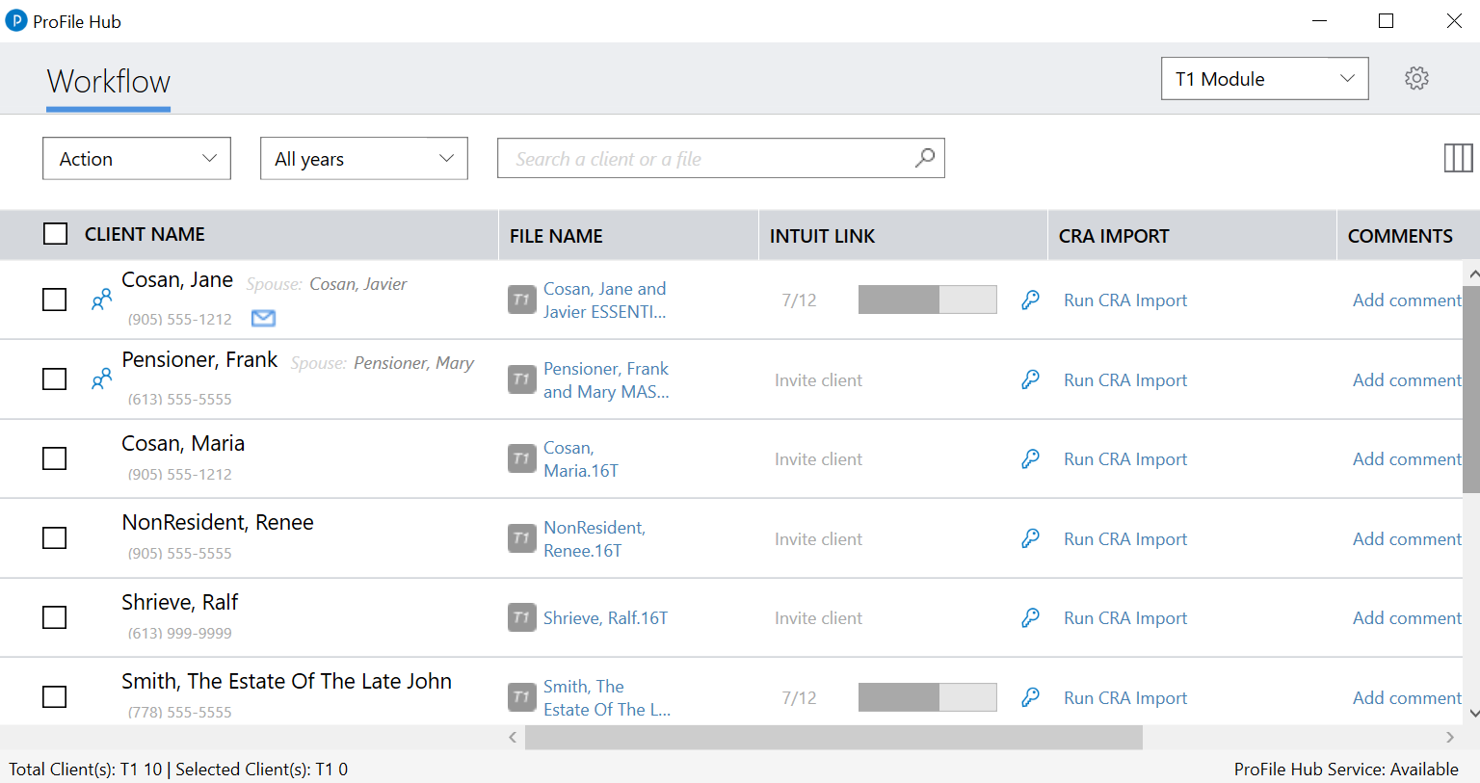
Page 19
Hub
Notes:
Demo a tour of Hub
Discuss the columns, (Client & File Name, CRA Import, Log-in icon, Comments, Status)
Point out T1 & T2 Module Dropdown
Demo Tax Years Dropdown

Slide 18
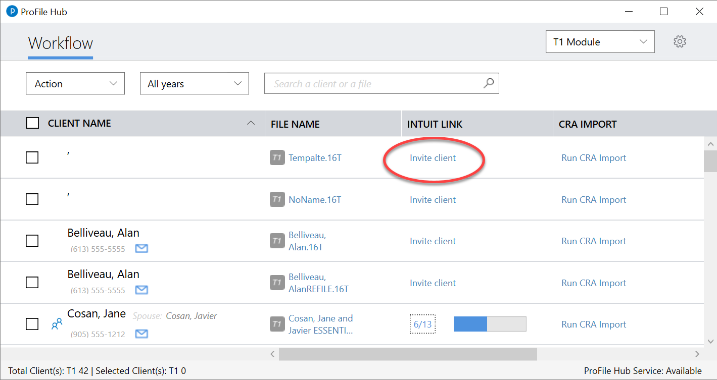
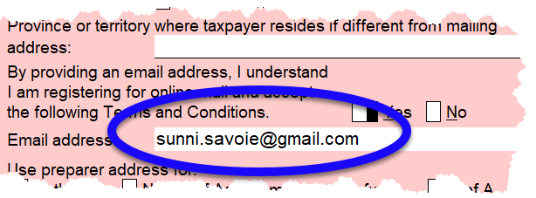
Page
20
Hub
Notes:
Mention client’s email is required to invite a client Link

Slide 19
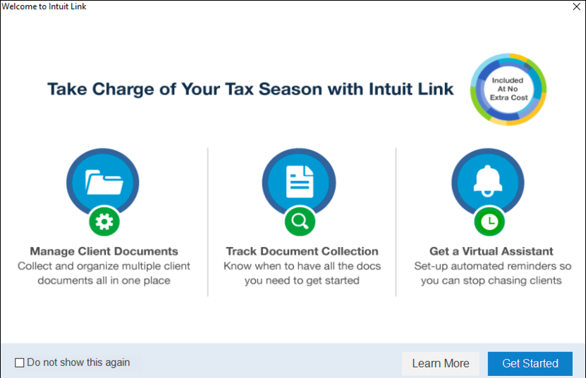
Page 21
Link
Notes:
Describe the splash screen at page 21
Click Get Started to continue

Slide 20
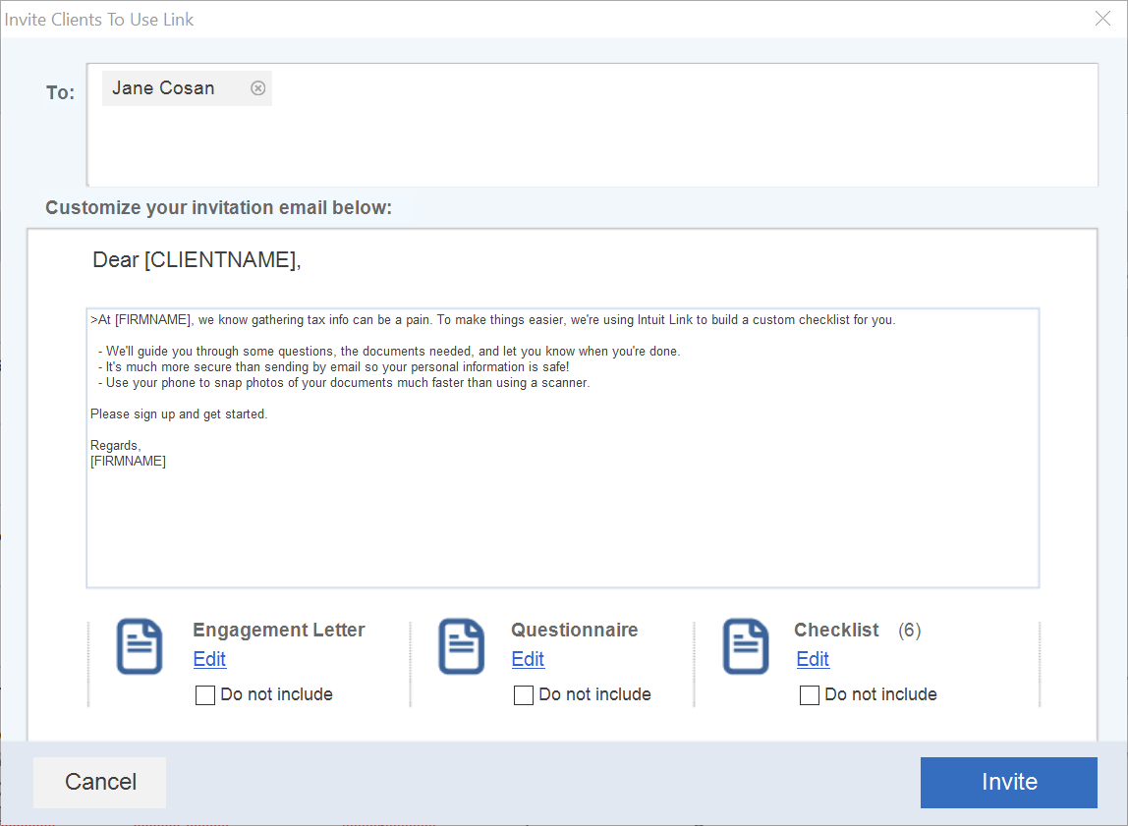
Page 22
Link
Notes:
Demo how to work with the default templates – Including Editing and Adding templates like a questionnaire – Page 22
Refer to Page 23 - Go back to Hub to show the client status in the Link column

Slide 21
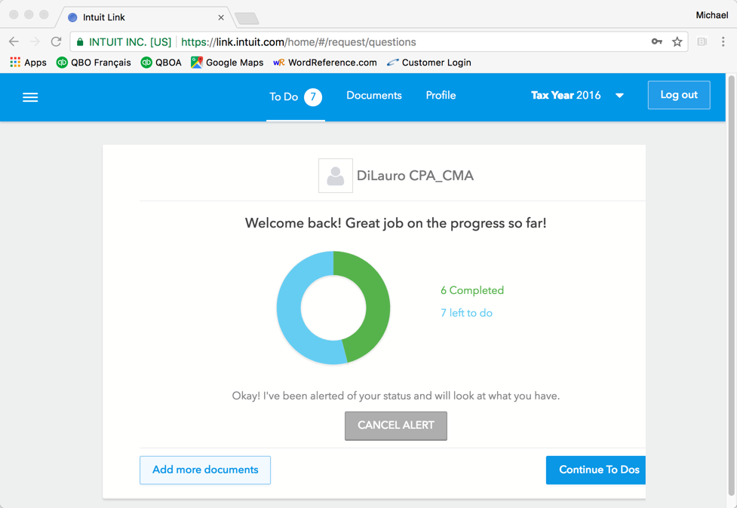
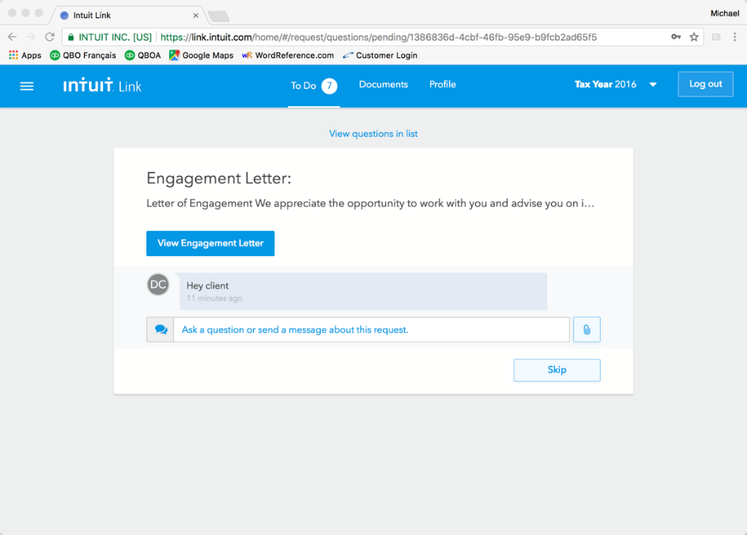
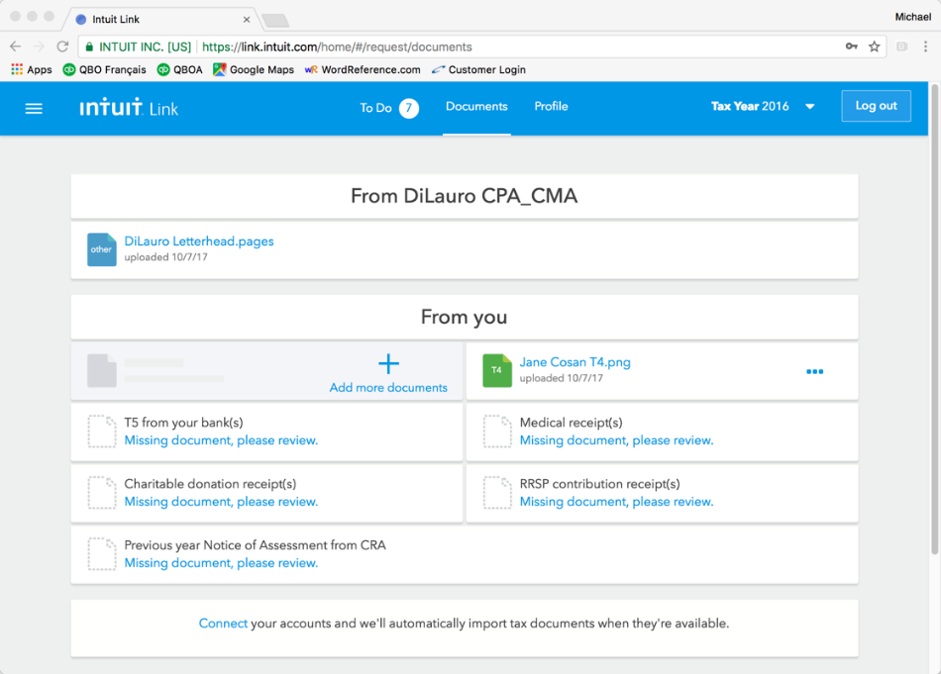
link.intuit.com
Client portal
View /upload documents
Ask/answer questions
Page 23
client view
Notes:
Here is the client’s view after she logs in at link.intuit.com
Demo how to work with the default templates – Including Editing and Adding templates like a questionnaire – Page 23
Go back to Hub to show the client status in the Link column
Point to Pg 24 of the manual and discuss how a client logs in, and what the client sees after they accept the invitation
Go back to Hub, click on the Progress Bar icon to access the Link online portal Page 23

Slide 22
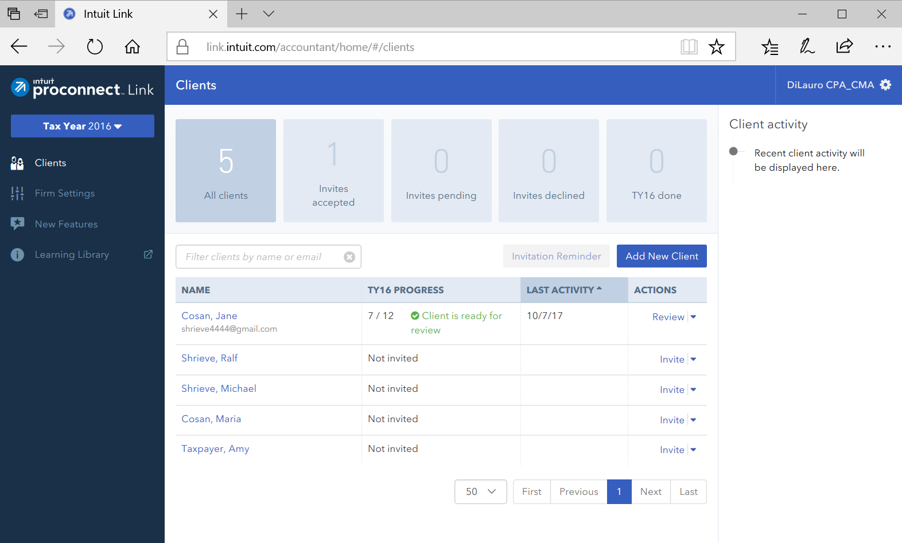
Navigation Bar
Gear icon
Filter buttons
Client list & status
Page 25
preparer view
Notes:
Refer to instructions at Page 25
Click a client that has already accepted the invitation and you will see this Link dashboard
Mention the Navigation Bar (Tax Years, Clients, Firm Settings, New Features)
The Gear Icon
The Filter buttons
The Client List with status
Next Click on Cosan to go to Client Details window
Last thing: Go to http://link.intuit.com/accountant to access the Link portal from your browser – Page 27

Slide 23
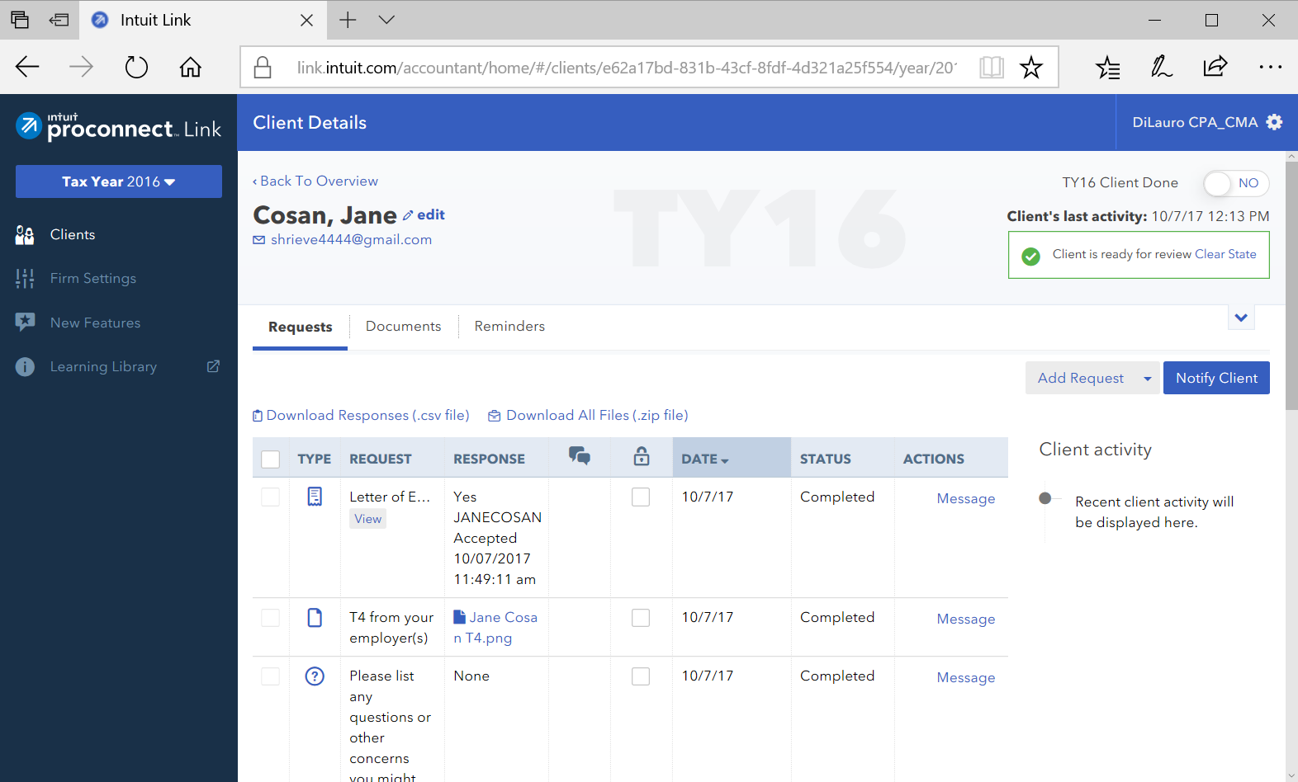
Request tab
Documents tab
Reminders tab
preparer view
Notes:
Refer to Page 25
Go through the features of the Client Details window
Three Tabs (Requests, Documents, Reminders)
Discuss the Documents tab to view both sent and received documents – Page 26

